Slide 1
F# - Trading Strategy Backtester
Eric Dircks and Henian Wang

Slide 2
Overview
F# Introduction
Purpose
Data
Reads
Applicable Business Function
Tools
Architecture
Demo
Future

Slide 3
F# Introduction
Open source functional programming language adopted by Microsoft and ported to use the .NET Framework.
Strict compile time type checking.
Relatively good performance, excelling specifically in recursive and parallel functions.
Decent open source community but lacks a serious presence in practice.
Strong development environment option in Visual Studio.
F# Interactive

Slide 4
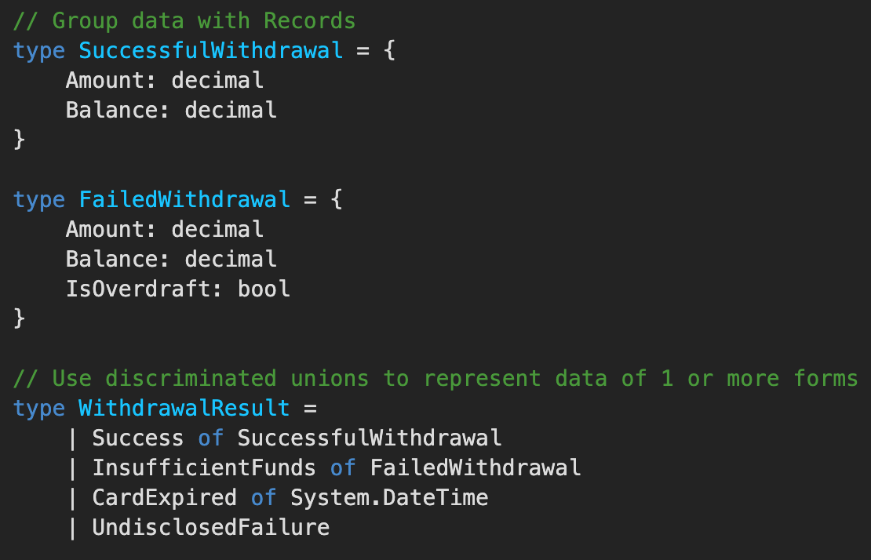
F# Introduction - Rich Data Types
F# is a ‘pure’ functional language which emphasizes immutability in it's programs.
Ability to create various types to model whatever information is required in a given application.
Discriminated unions are high level types whose type can be different depending on the state of the program.
Almost like a generic enum that can be type agnostic.
Source: Microsoft

Slide 5
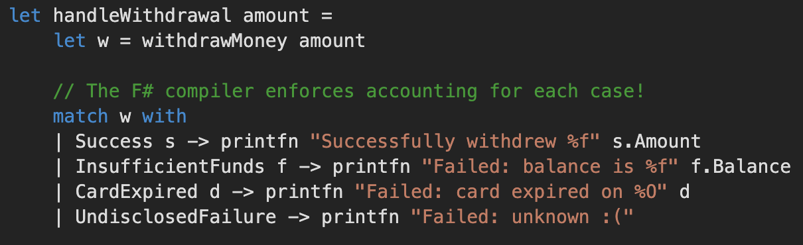
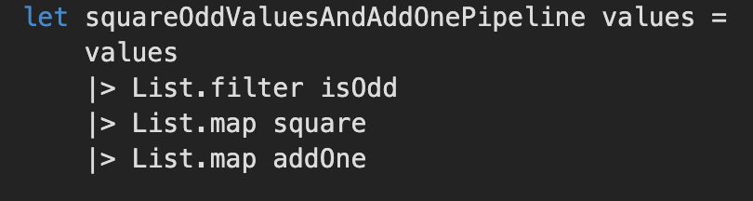
F# Introduction - Pattern Matching & Pipes
Pattern matching is powerful tool when comparing the output of a given function with a set of possible outcomes and their respective actions.
Pipe functions offer a cleaner method of calling a procedure of functions without storing their results in intermediate variables.
Source: F# Tour, Microsoft

Slide 6
Project Purpose
With writing software comes the inevitability of bugs and unexpected behavior so it's always helpful to test prior to moving to production.
When trading stocks or options programmatically it would be ideal to be able to backtest a trading strategy against historical data before moving into production and putting money on the line.
Since F# has strict compile time type checking, the ability to create custom types, and a variety of statistical and mathematical libraries, it is a strong language for this type of application.
Once the algorithm is developed it can be validated and tested against historical stock data.

Slide 7
Data - Reads
The application needs historical stock data to run the trading algorithm on. There are a number of APIs to choose from.
Intrinio
$40 / month
Polygon.io
$199 / month
Alpha Vantage
FREE!!
We chose Alpha Vantage because they offer a quick and easy signup, cost effective, and a variety of data.
Stocks
FX
Crypto

Slide 8
Applicable Business Function
The target audience for a trading strategy backtesting application like this would be quantitative investors, researchers, and students so they can test their algorithms against historical data.
Hedge Funds
Investment Banks
Home Offices
Researchers
Students

Slide 9
Tools
Libraries
Deedle
Time series and data processing
F# SQL Client
F# LINQ
ORM compatibility, simple ETL
FsUnit
Unit testing
IDE
Visual Studio/Visual Studio Code
Platform
.NET Core for cross platform compatibility
ORM
Entity Framework
Database
SQL Server Express
‹#›

Slide 10
Architecture
Attempted a Three-Tier Architecture but it turned out that the F# paradigm doesn’t blend well with object oriented architectures.
There is somewhat of an architecture within the software but structurally it's flat architecture.
Execution script sets various configuration variables such as the stock ticker and the number of days for the moving averages.
The API is called to retrieve the data.
The trading algorithm is passed to the trade execution code.
The results of the algorithm are returned to the execution script.
The results are passed to the plotting function to display the results in the GUI.

Slide 11
Demo
https://github.com/tedircks/gwu

Slide 12
Future Plans
Add functionality to allow algorithms to be written from a GUI.
Web based application.
User accounts to save algorithms and their profitability.
Add support for FX, Options, Crypto, and FI trading.
Real-time processing.
Greater variety in data selection.

Slide 13
Questions?

